Slide 1
Numerical Details on Schur Conditioning

Slide 2
Phase 1: Scan through variety of wavelengths to ascertain how singularities might affect the conditioning

Slide 3
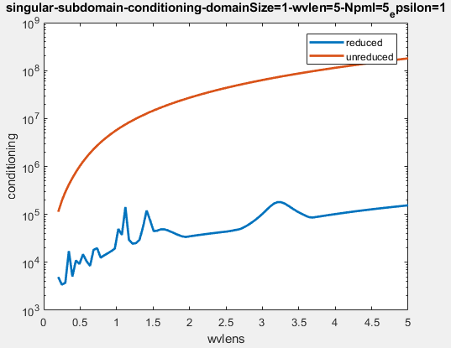
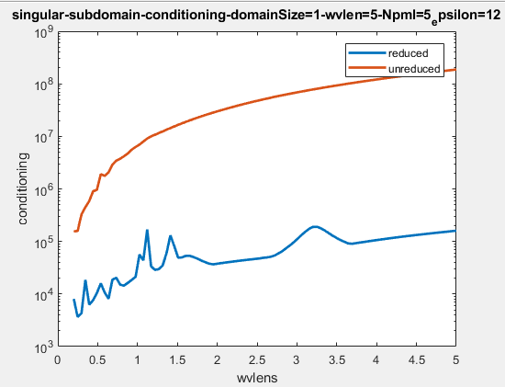
Intentionally Singular Subdomain

Slide 4
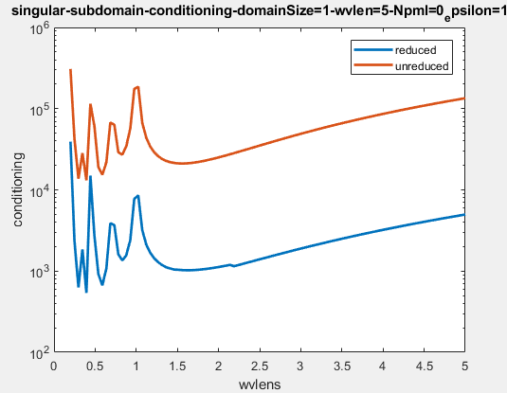
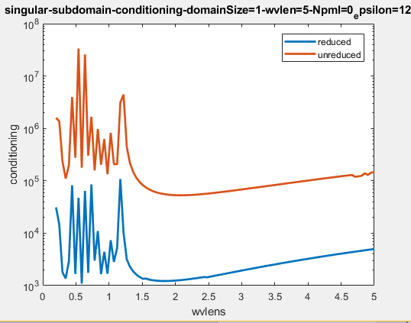
No PML

Slide 5
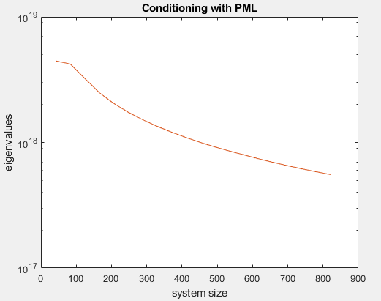
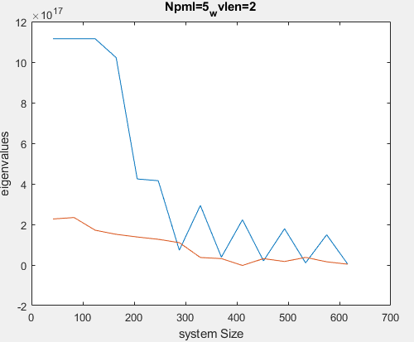
Scaling of Smallest Eigenvalues
Smallest eigenvalue scaling is actually not so easy to numerically verify because the operators implemented are dirichlet
But a PML is the closest we can get
The argument makes sense if we consider operators with Dirichlet boundary conditions!
Parameters: 1x1 micron unit cell size
Wvlen = 2 micrometers

Slide 6
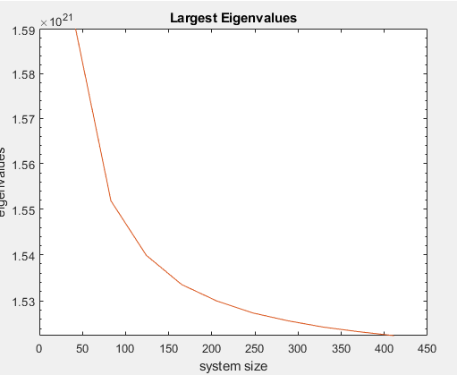
Make Sure Scaling of Largest Eigenvalues Is Constant
Looks like it’s decreasing, but the proportion is really small, 0.03 out of 1.6, whereas in the smallest eigenvalue, we see order or magnitude change

